Slide 1


Secure Your Legacy:
Creating & Updating Wills, LPAs & IHT
Will
Speakers - Lynsey Colman
Date - 8th October 2024
Copyright © 360 Law Group Limited, London, 2024. All Rights Reserved.

Slide 2


Introducing your Speakers
Lynsey qualified as a lawyer in 2005 and specialies in Private Client work, including Wills, Trusts, and Probate
Lynsey is known for delivering highly personalised and empathetic legal services, ensuring her clients fully understand their options and outcomes.
Lynsey Colman
Lead Private Client Solicitor
Copyright © 360 Law Group Limited, London, 2024. All Rights Reserved.

Slide 3
Agenda
Wills
Lasting Power of Attorney
Inheritance Tax and Lifetime Gifting
Questions & Answers
Copyright © 360 Law Group Limited, London, 2024. All Rights Reserved.

Slide 4

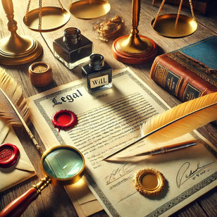

Wills
What is a will?
Why you should have one.
What happens if you don’t?
Process overview
Copyright © 360 Law Group Limited, London, 2024. All Rights Reserved.

Slide 5
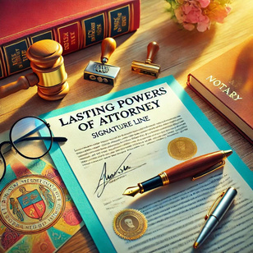
Lasting Powers of Attorney
What is an LPA?
Why you need one
What happens without an LPA
Process overview
Copyright © 360 Law Group Limited, London, 2024. All Rights Reserved.

Slide 6

Inheritance Tax & Lifetime Gifting
Inheritance tax overview
Lifetime gifting rules
Copyright © 360 Law Group Limited, London, 2024. All Rights Reserved.

Slide 7


Questions?
enquiries@360lawgroup.co.uk
0333 772 0926
Copyright © 360 Law Group Limited, London, 2024. All Rights Reserved.

